Slide 1
Graph Theory 2
Graph traversal :
BFS and DFS

Slide 2

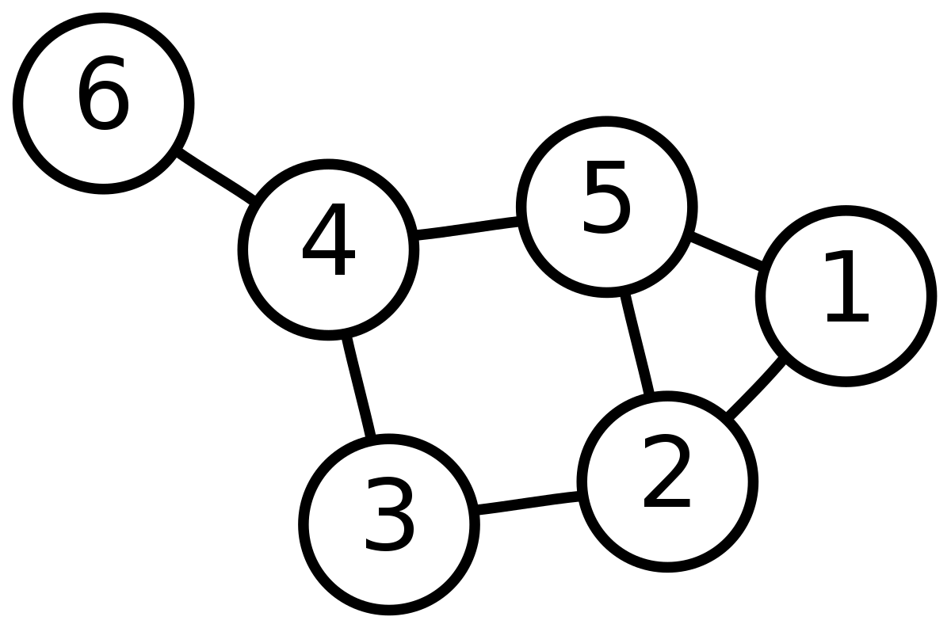
Graph traversal
What is it ?
-> A method to explore a graph from a given node (every node accessible)
Purpose ?
Quickly explore the graph (useful for some problems).
Foundation for more advanced algorithms (we’ll see this in the following weeks).

Slide 3
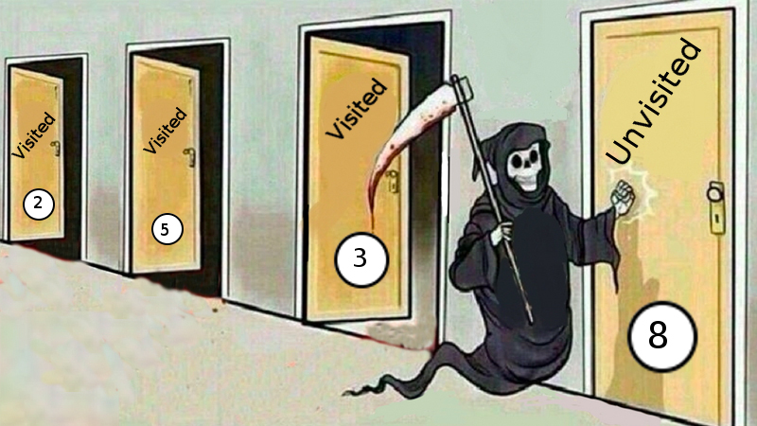
Big notions used
Visited/unvisited:
To explore the graph optimally (a node is explored only once) we need to keep track of which node has been already visited
Main data structure:
The data structure used to keep track on which node will be visited next.
Additional data structure:
May be used to keep track of various informations depending on the context

Slide 4
Two algorithm for the price of one:
BFS
Breadth-first search
-
Explore first the nearest nodes from the current position
FIFO - Queue
DFS
Depth-first search
-
Go as deep as you can and backtrack when you’re in a dead end
LIFO - Stack

Slide 5
A small demonstration
BFS
DFS

Slide 6
5
BFS
1
BFS(G, start):
let q be a queue
add start to the queue
set every node of G to unvisited
set start to visited
while q is not empty:
current is the next node from q
for every node a_{i} adjacent to current:
if a_{i} is visited: skip
set a_{i} to visited
put a_{i} in q
10
6
4
11
12
3
2
9
8
Complexity : O(E+V)
7

Slide 7
5
DFS
1
DFS(G, start):
let s be a stack
add start to the stack
set every node of G to unvisited
set start to visited
while q is not empty:
current is the next node from s
for every node a_{i} adjacent to current:
if a_{i} is visited: skip
set a_{i} to visited
put a_{i} in s
10
6
4
11
12
3
2
9
8
Complexity : O(E+V)
7

Slide 8
Why two variants ?
BFS
Find the shortest path between two nodes when the edges’ weights are equals
DFS
Possibility to implement a recursive version
Give the topological order of the node in an oriented graph (which can be useful for some shortest path application)

Slide 9
Credits
More resources:
DFS : https://en.wikipedia.org/wiki/Depth-first_search
BFS : https://en.wikipedia.org/wiki/Breadth-first_search
Cours de 3IF : https://moodle.insa-lyon.fr/pluginfile.php/317641/mod_resource/content/1/cours.pdf
Slides: Sebastien Goll for INSAlgo

